Slide 1
UKFC’s Digital Innovation in Distribution Fund
Peter Buckingham
Head of Distribution and Exhibition
Peter.buckingham@ukfilmcouncil.org.uk

Slide 2
Reasons For Developing the DI Fund
  To help independent rights holders better utilise new online tools and services to reach their audience
  Data, data and more data!
  (lack of) cinema bookings (but why?)
  To encourage the indie sector to take advantage
  To be able to share data and learnings from the supported projects with the wider industry so that the scheme has the largest possible impact

Slide 3
Main criteria
  Applications to demonstrate innovation and experimentation in the use of digital marketing tools and online opportunities
  Long lead
  Clear strategy and measurable KPIs
  Successful applicants required to publicly share the results of this marketing activity - whether positive or negative (as per previous slide)

Slide 4

Digital Innovation Campaign Outline – R/date 12 March 2010

Slide 5
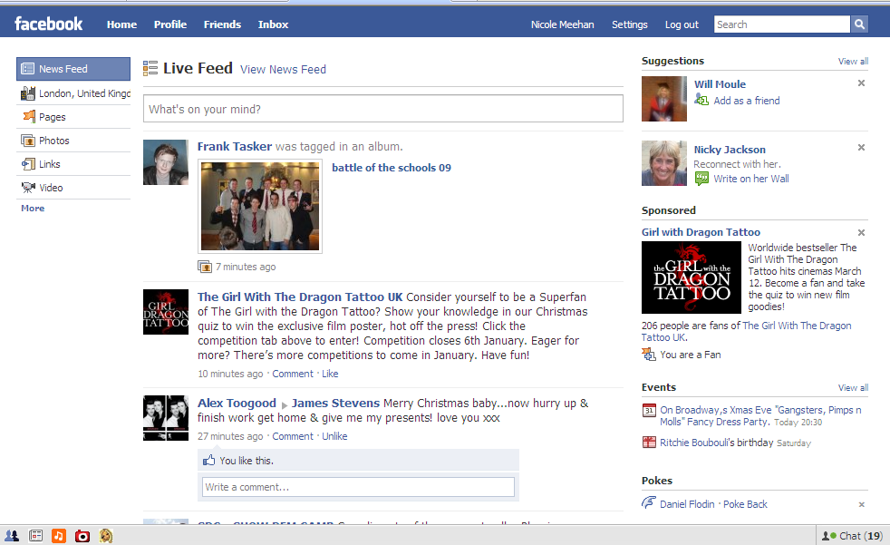
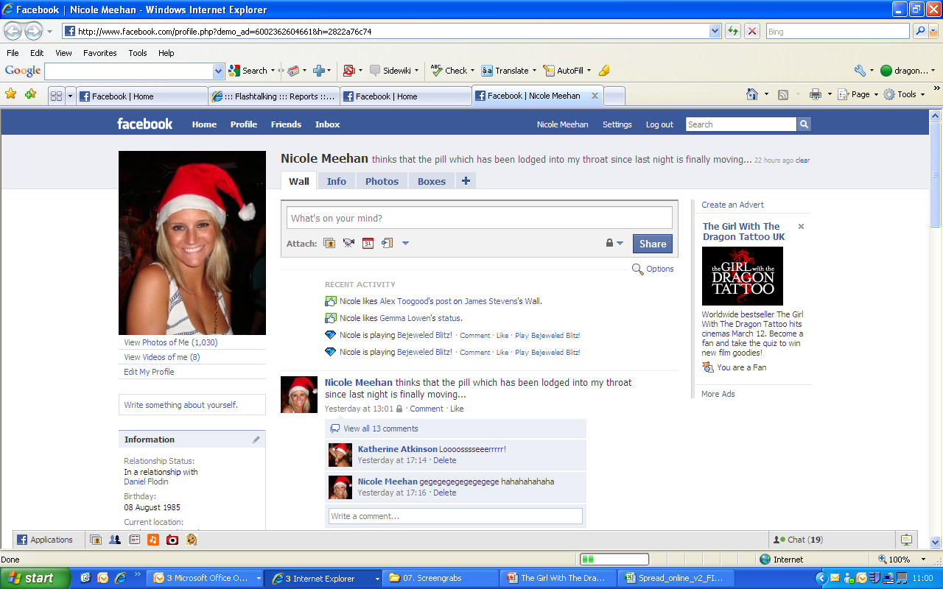
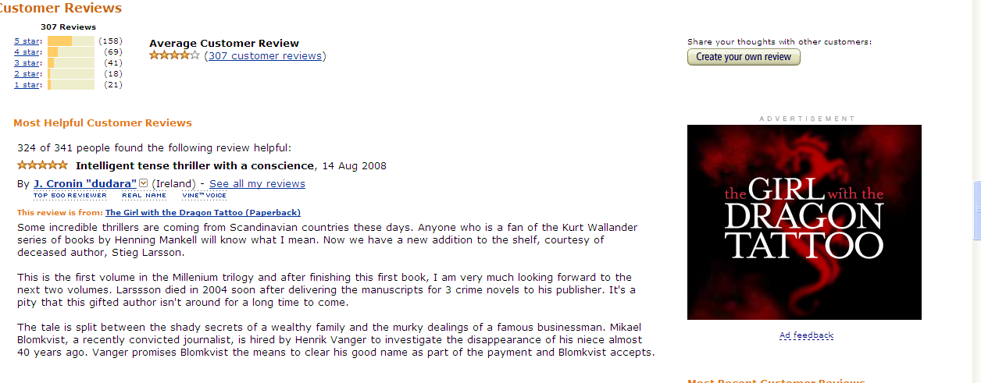

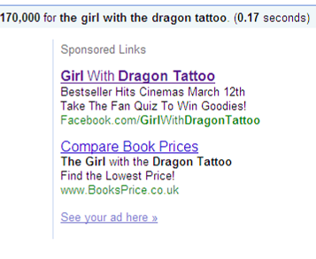
Capitalising on the Christmas online rush, ads ran on Facebook, Amazon & Google, targeting book fans and recruiting them to become Facebook fans

Slide 6
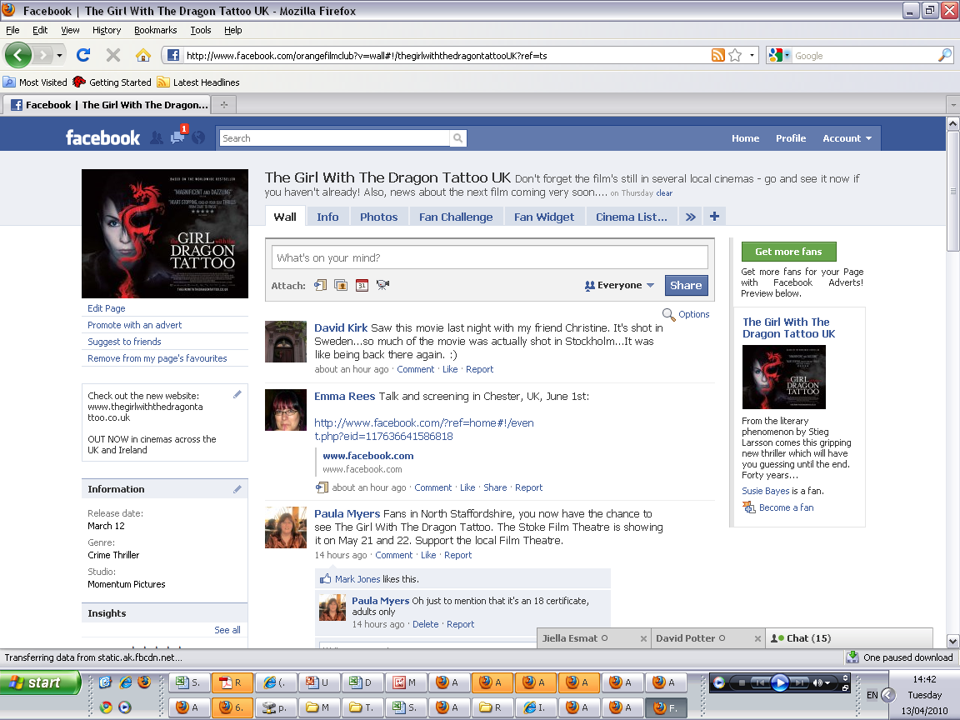
Facebook excites fans with exclusive poster competition giveaways and links through to the interactive website with regular posts & links.

Slide 7
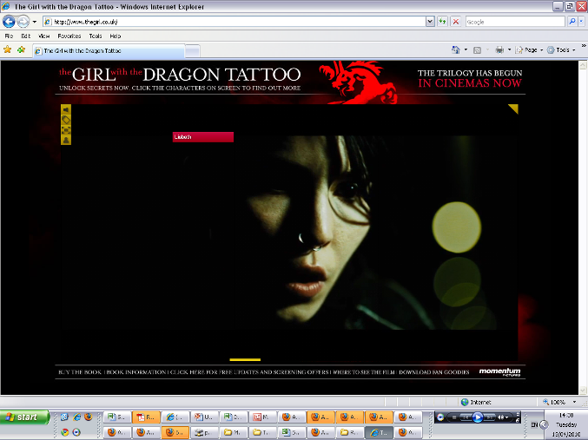
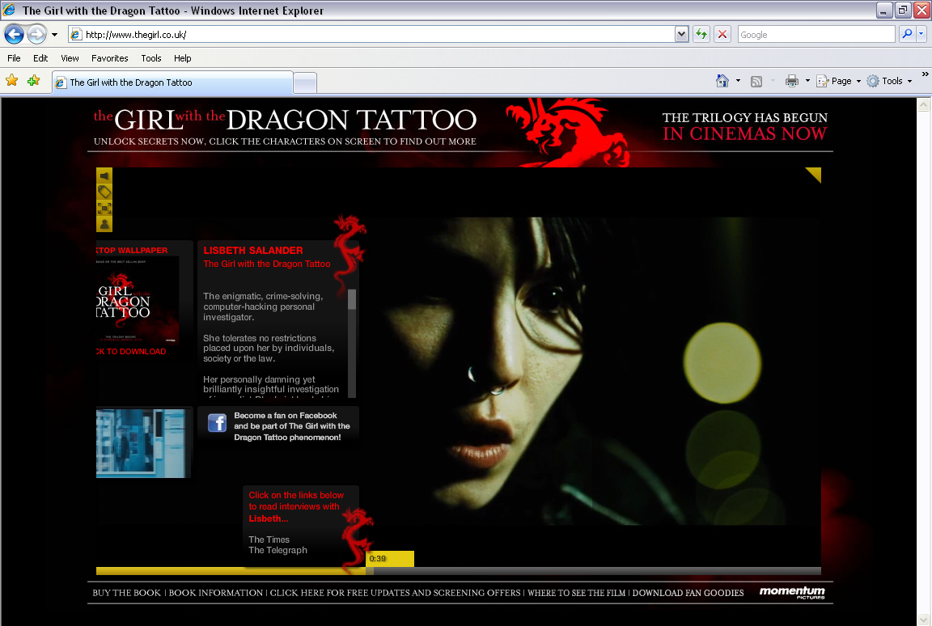
http://www.thegirl.co.uk/
Website is interactive: trailer plays, and when users hover mouse over characters, they see clickable highlighted words. Clicking in reveals hidden content.

Slide 8
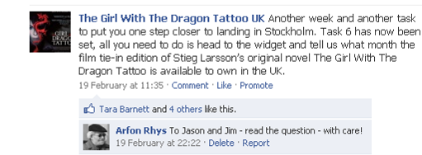
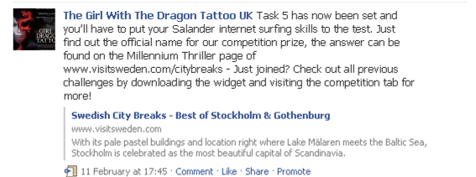
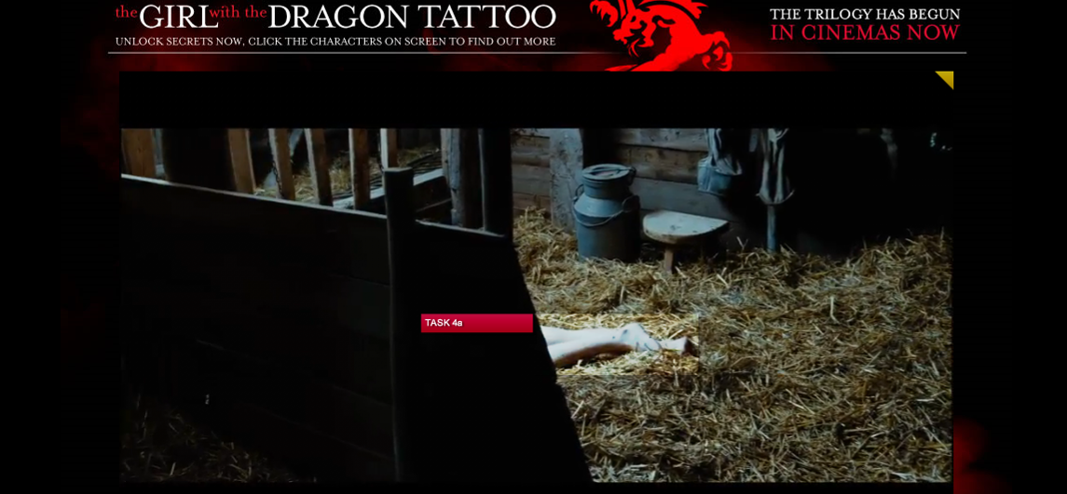
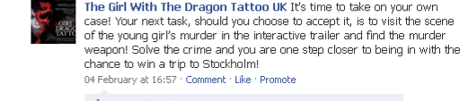
Phase 2 – Jan-March 2010
Facebook fans are given one question/task to answer each week over 9 weeks – for the chance to win a trip to Sweden. (They can answer old questions at any time)

Slide 9
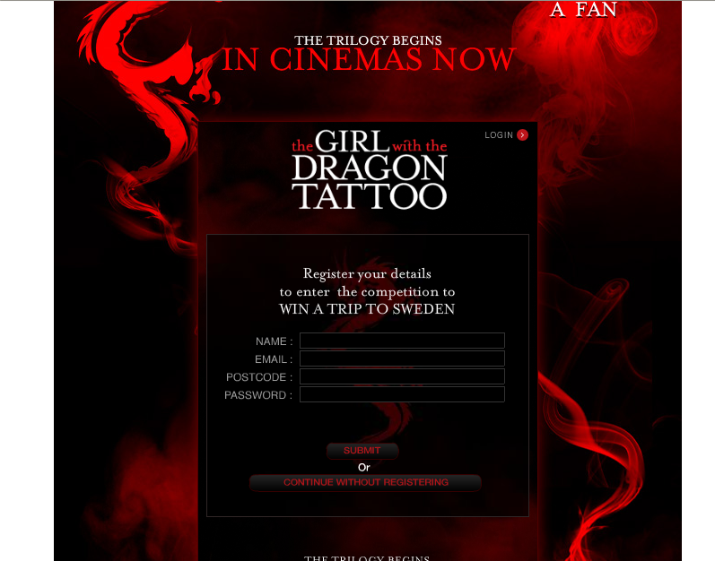
Fans answer questions via a widget, downloadable on Facebook, also containing key content, wallpaper, trailer etc. User updates are shared on friends’ walls

Slide 10
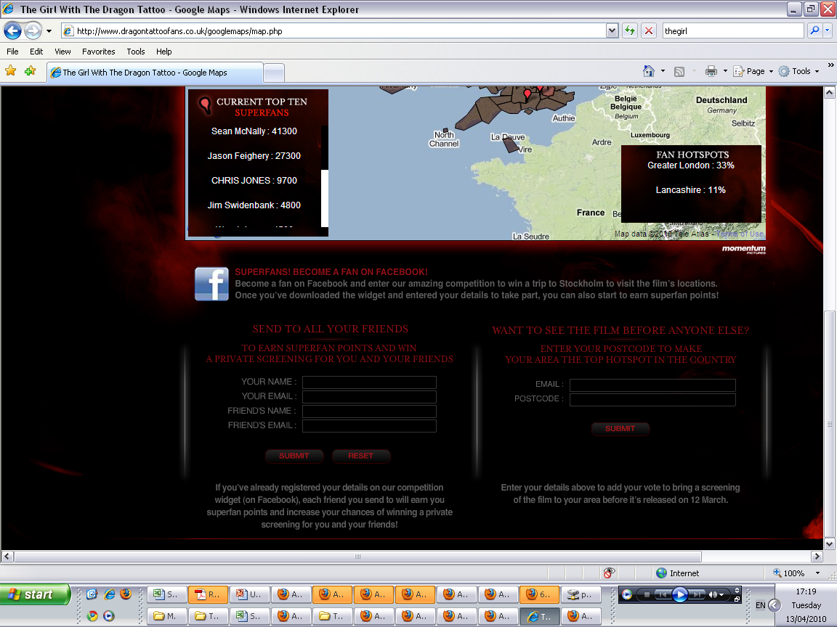
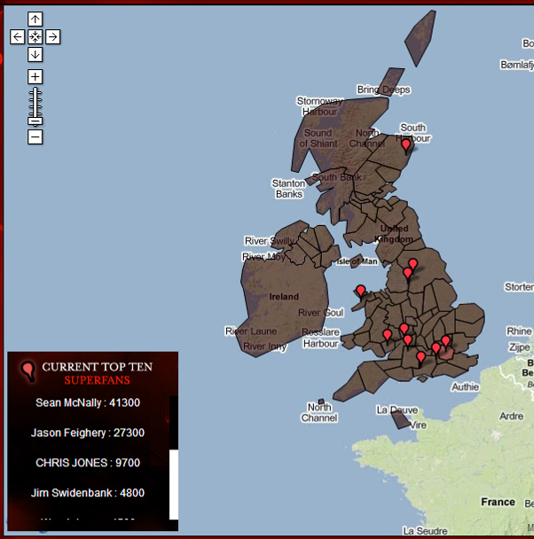
Each time fans send content on to friends, they earn Superfan points. The ultimate Superfan wins their own pre-release private screening of the film

Slide 11
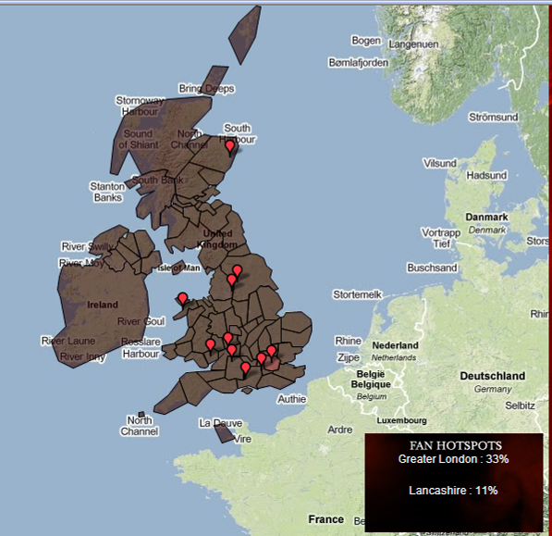
Fans can also vote to bring a pre-release screening to their area, encourage their friends to vote too – and see the area’s popularity growing on the interactive map

Slide 12
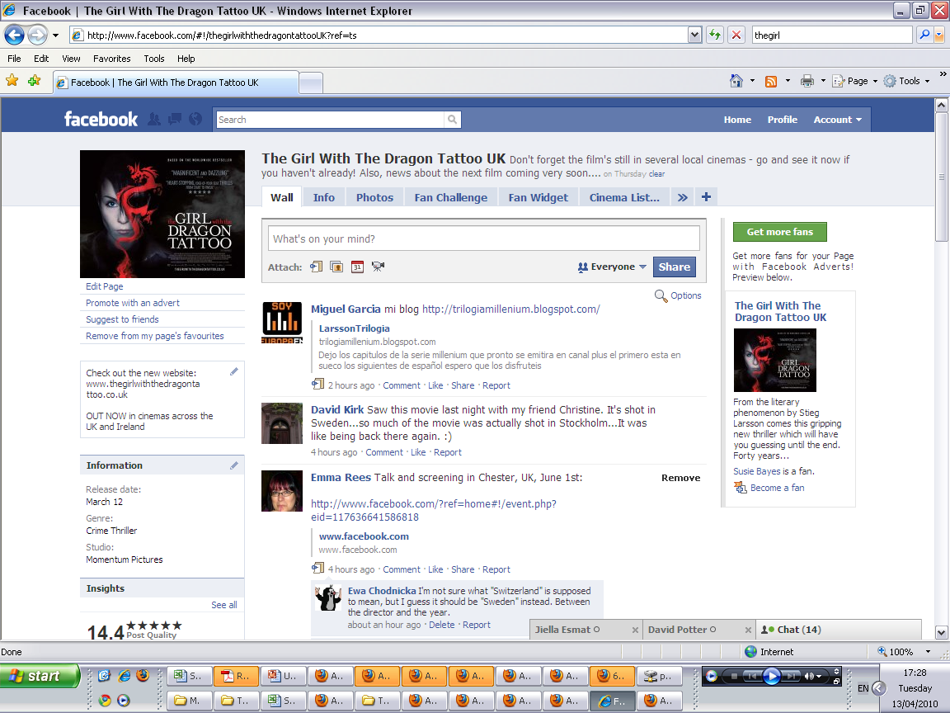
After release, Facebook continues to be the hub for fans to share info about the film- and to show cinema listings etc

Slide 13
Girl Results
15 million saw the Facebook activity seeding
65, 000 visitors to website
5502 very active Facebook fans
Competition underperformed >400
Box Office to date: £2.2m

Slide 14
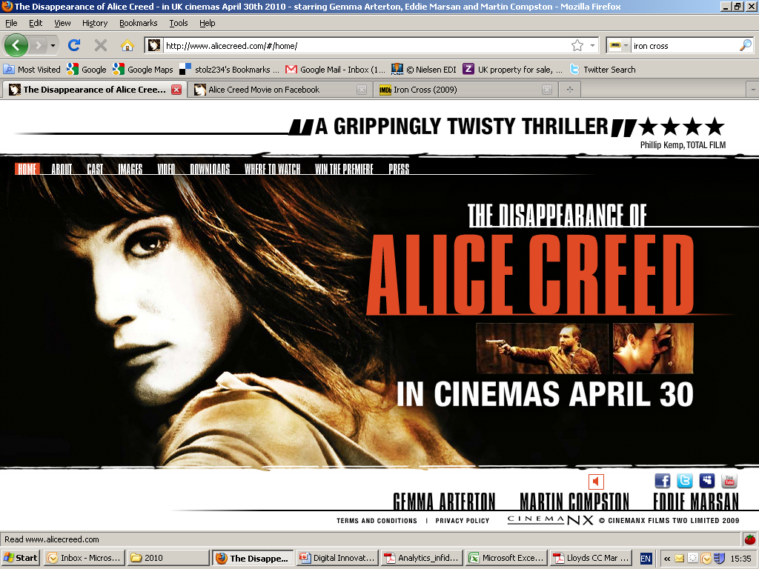

Slide 15
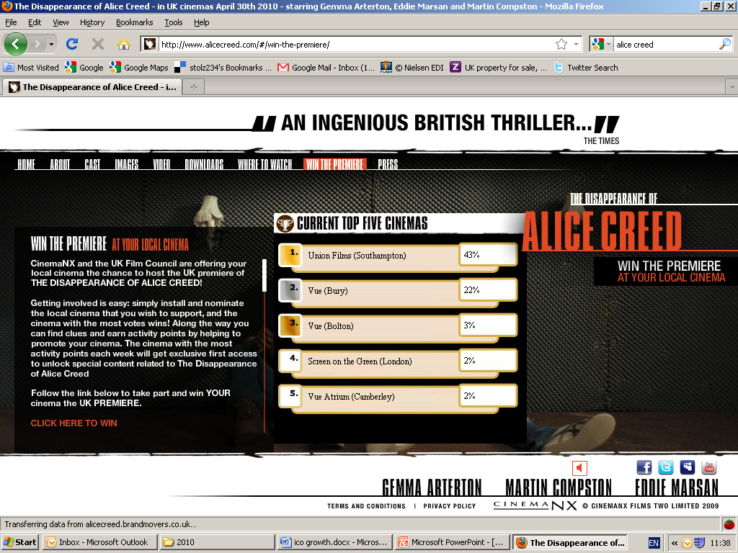

Slide 16
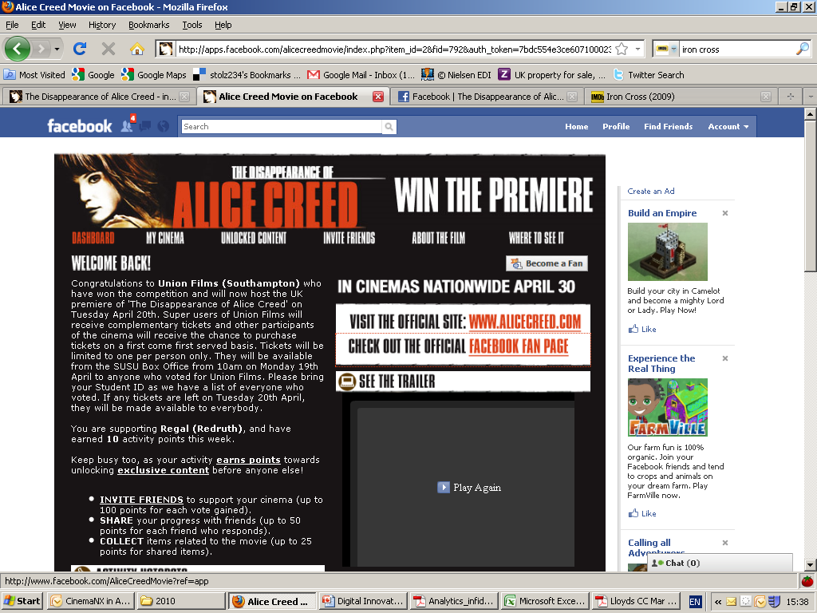

Slide 17
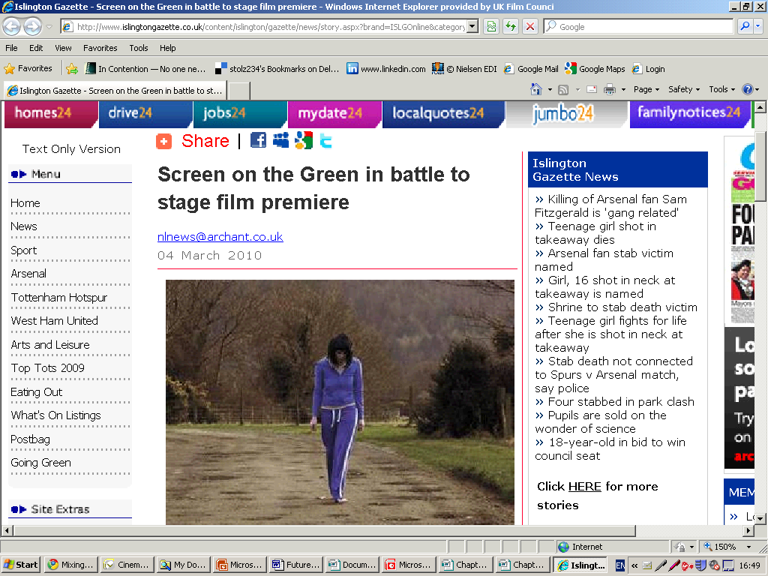

Slide 18
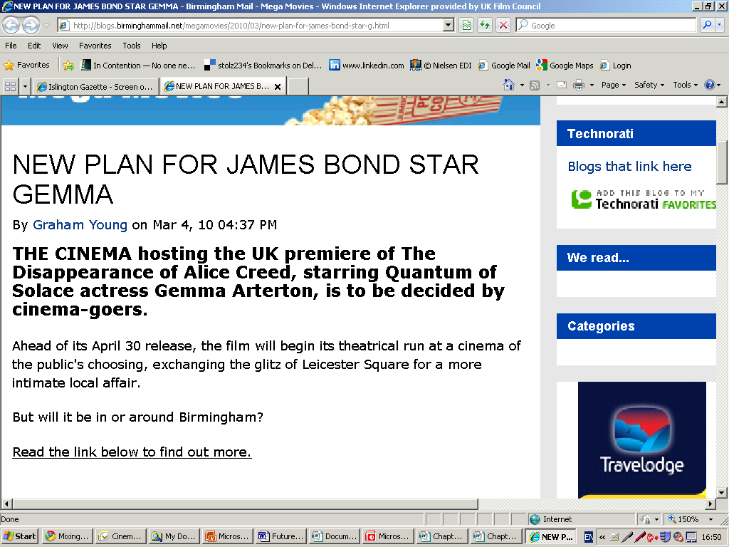

Slide 19
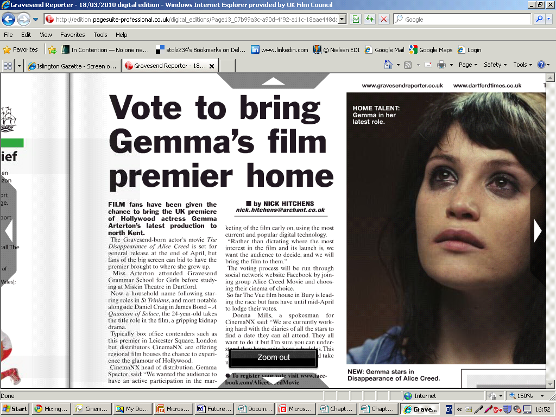

Slide 20
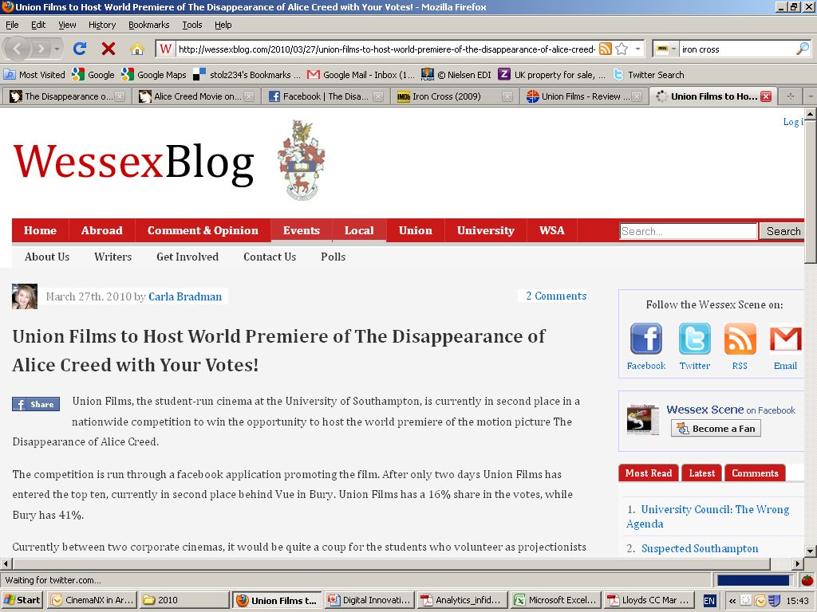

Slide 21
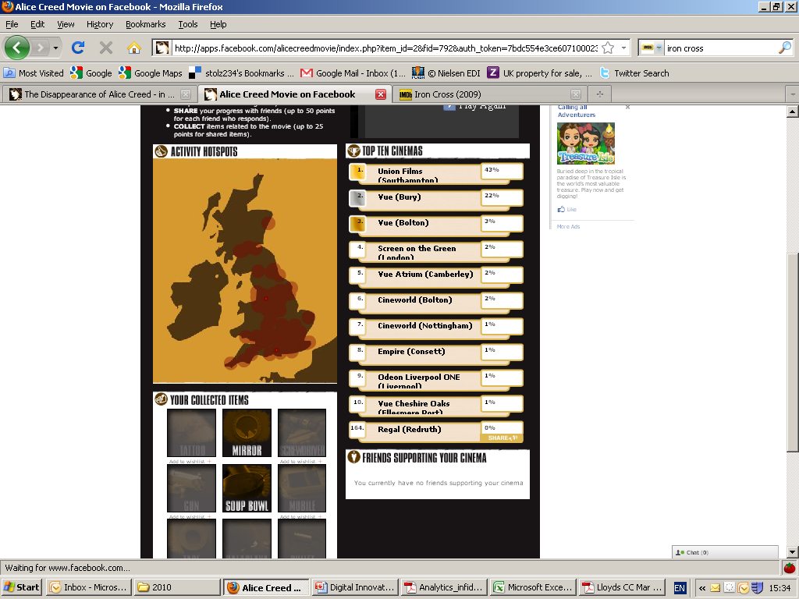

Slide 22
Alice Creed Results
Facebook App - Total Shares: 991, Total Invites: 6271, Total installs: 2037, Facebook Active Users 6557
Total Number of votes: 2037 Winner: 800
Box office of over £400k following an initial 67 print release
A 4-day weekend screen average of nearly £3000, beating the blockbuster Miley Cyrus vehicle The Last Song, on their opening weekend screen average.
Close to three months after its April 30 release, the film was still playing off-dates across the country
Industry acclaim – nominated for Premiere of the Year in Screen International’s Screen Awards 2010, up against Avatar and Twilight: suggesting an innovative marketing campaign for a lower budget indie film could succeed in a competitive
marketplace

Slide 23
Metadata!
What is Metadata? Data about Data.
Metadata is information about a thing, apart from the thing itself.
E.g. Music CDs have artist, title, track listing, ISRC number etc.
Clothes have size, washing instructions and manufacturer.
Food packages have weight and nutritional information.

Slide 24
Film Metadata
Title
ISAN number
Credits
Cast
Script
Synopsis
Distributor
running time
related media links stills
study guide
opus
ratings
certificates versions/formats available
production formats
time code
audience comments
audience demographic data
licensing
budget
finance sources
subtitles and dubbing
platforms where it is available
website info
contact info
awards
music info
screening/release history,
scene-by-scene description
time code of each element
country of origin
call sheet
money path
categorisation
genre
chapter points
technical specs
frame rates
codec
resolution
sound specs
camera meta data
location and geo-tagging
artistic information
wardrobe
key props
parent or project info
products
breakdown sheet
cost of each element
The list goes on…….

Slide 25
How could Metadata help on ROI for product placement?
If product placement was captured for each production and in a standardised format, new possibilities and business models could emerge to aid in ROI opportunities.
Standards in Metadata are established, including types of data, method of capturing, etc.
Data is captured in production (including product placement information) and made available .
New or existing businesses can access the data for new ways of ROI for brands, and new ways of value to audience
Enhanced offering to potential brand partners in film financing
  What could it look like for audiences and film investors?
Notes:
25

Slide 26
Innovative use of metadata for film
Uses metadata that remains persistently and dynamically associated with an item of content (the film)
Has strategic importance that can be used to drive value and support the emergence of new revenue models
Helps rights holders develop stronger relationships with their consumers and help identify new commercial opportunities

Slide 27
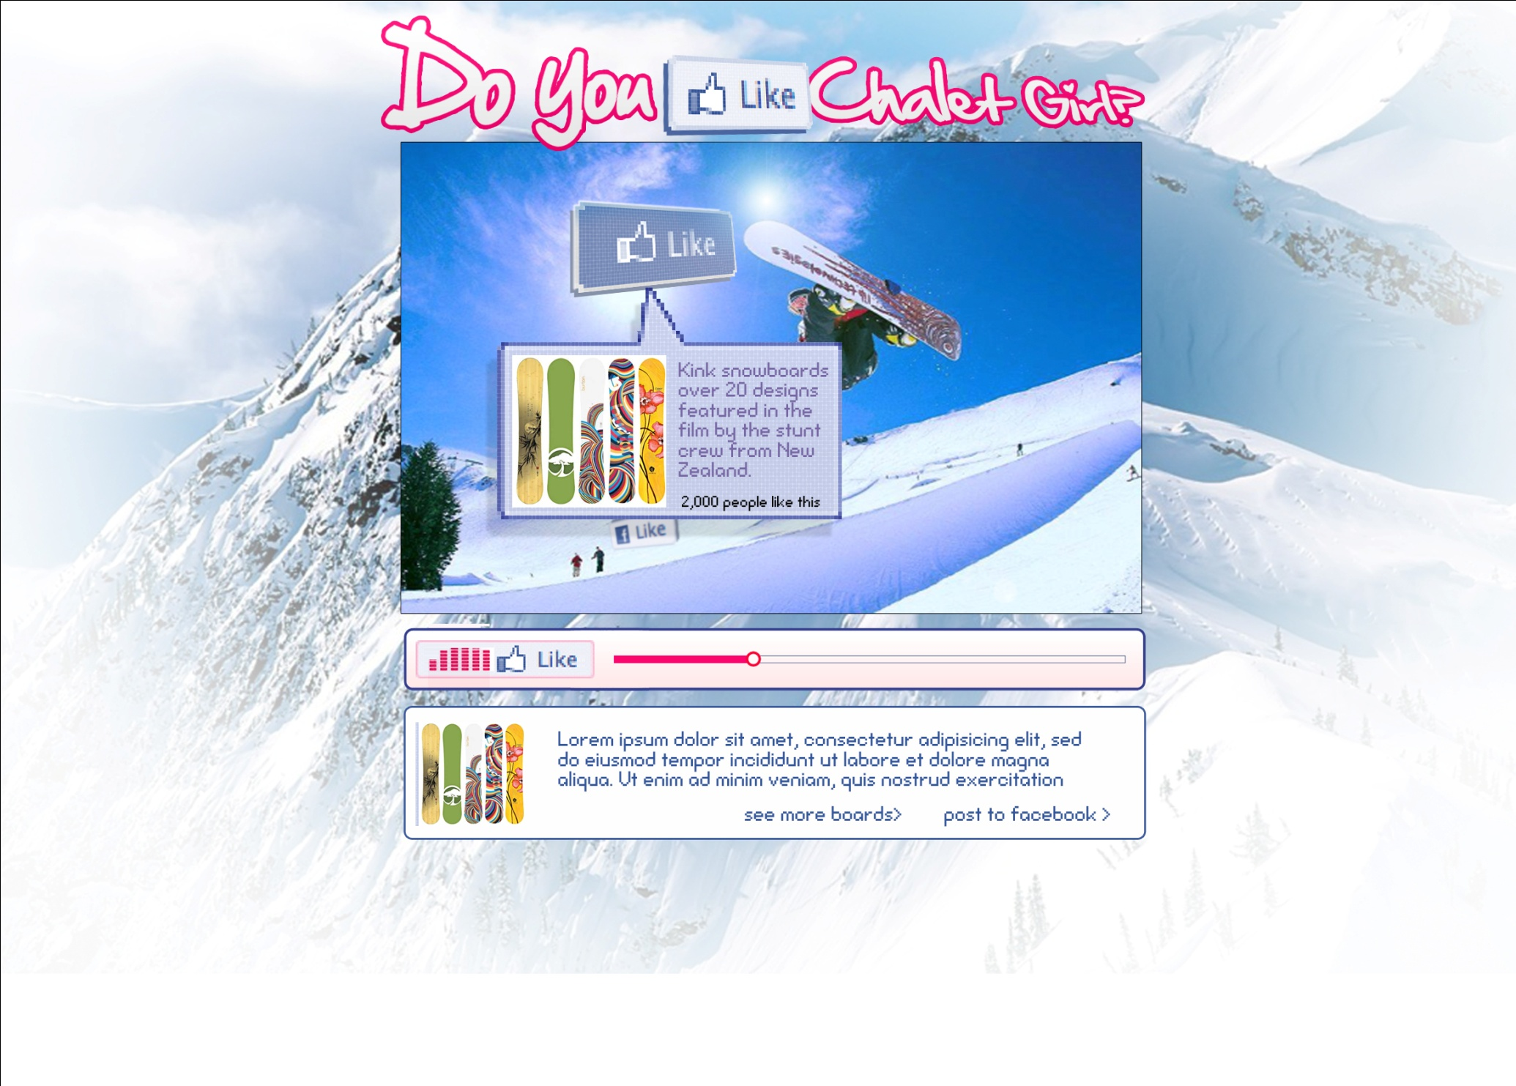
CHALET GIRL – Release date Feb 2011

Slide 28
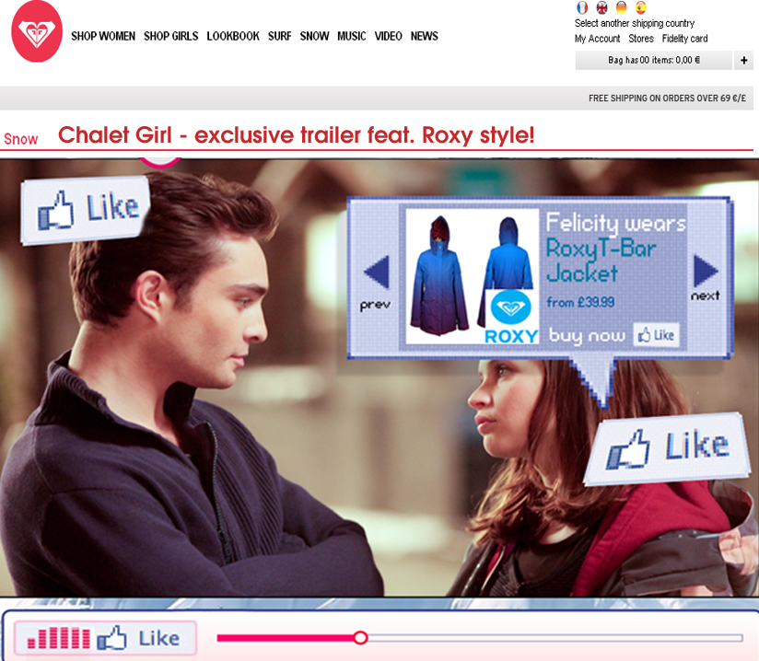
Stage 1: View promotion or trailer on FindanyFilm through link on partner site

Slide 29
Stage 2: Arrive on page, video plays automatically

Slide 30
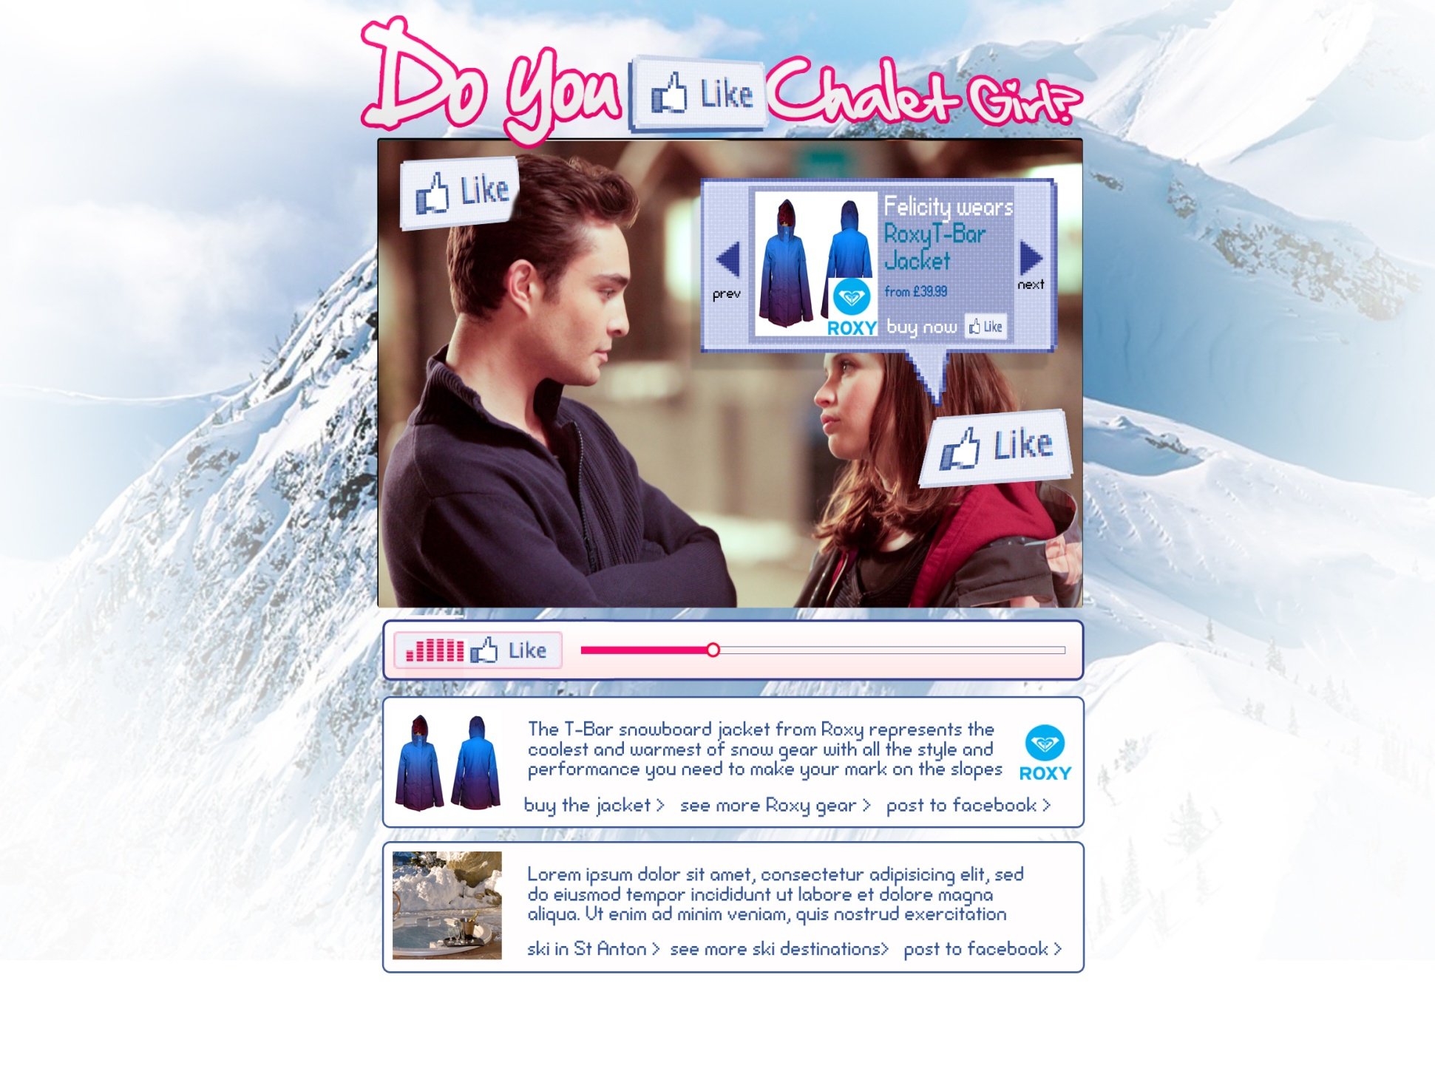
Stage 3: User interacts with trailer. Meta data collects below. User clicks ‘like’

Slide 31
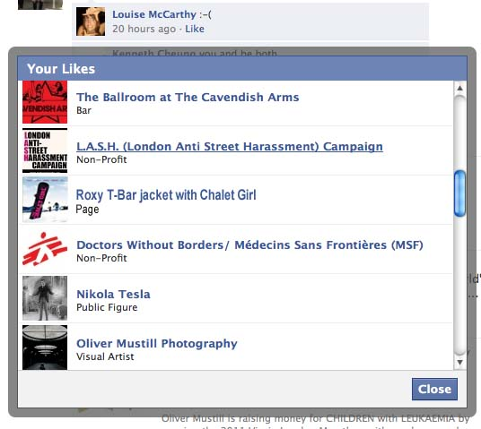
Stage 4: Clicked item (band/jacket/star) shows as ‘liked’ on FB. Appears in FB ‘likes’ to all friends.

Slide 32
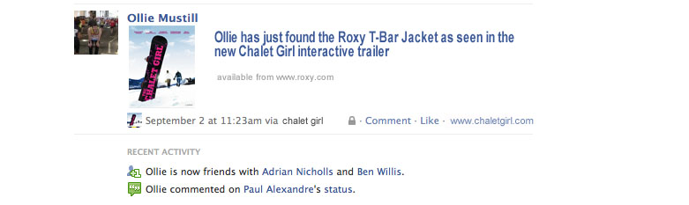
Stage 5: Post on wall about item ‘liked’. Entices new viewers to visit, watch and interact themselves.

Slide 33
Summary of Learnings
1. It is never too early to start planning your digital campaign
2. Simplicity of concept and design - A simple, uncomplicated user experience
3. Identify a clear target audience
4. Creating traction and driving awareness - the challenge of creating awareness of the campaigns in the first place
5. Integrating social media - one of the key strategic decisions to be taken at the outset
6. Conversions and measuring success - Exposure to a campaign doesn't necessarily translate into audience. The ultimate challenge, therefore, is one of conversion which means that the measurement of conversion is extremely important
Notes:
1. Several of the case studies report issues arising due to underestimating the necessary lead time. Equally, it is important to have built in the flexibility to adjust a campaign post-launch.
2. A user experience that is clear, uncomplicated and doesn't require too much time or effort from users appears to be an important quality.
3.Projects reported particular success when they identified a very specific target audience. Careful targeting and a clearer focus on a target audience generally lead to more efficient and effective campaigns.
4. Those which relied exclusively on online PR and seeding to do this struggled to bring in the numbers to make the campaigns effective. Conversely, the inclusion of an offline hook was an effective way of translating online awareness into something wider.
4. Without exception all campaigns employed Facebook as a core part of their strategy. However, there were different approaches to this, ranging from applications built directly on the Facebook platform to those simply using it as a communication channel. The platform's constantly changing Application Programming Interface (API) means that the question of how best to integrate Facebook and other social media platforms into a campaign is one of the key strategic decisions to be taken at the outset.

Slide 34

Thank You
Any questions?
http://www.ukfilmcouncil.org.uk/digitalinnovation
Peter.buckingham@ukfilmcouncil.org.uk
@Peterbuckingham

